Slide 1


Slide 2


Slide 3

Prague Christian Fellowship
4th Sunday
New Connections
Lunch
  Light lunch with new friends
  Get to know the pastors and a few leaders
  Learn the history of PCF, the core values, and ask anything!
Every 4th Sunday after the Sunday Service in the Sunday School room.

Slide 4



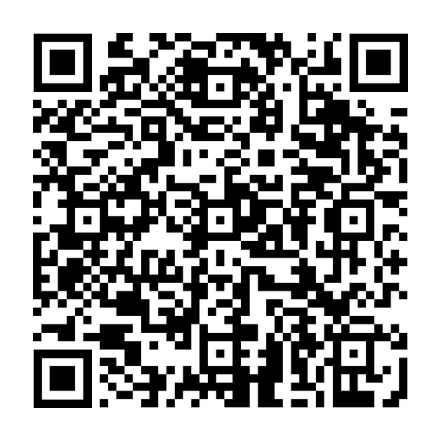
Open Heaven 2026
SCAN TO REGISTER
Bobbio Pellice, Italy
JUNE 4-8
WORSHIP ~ TEACHING ~ FELLOWSHIP

Slide 5


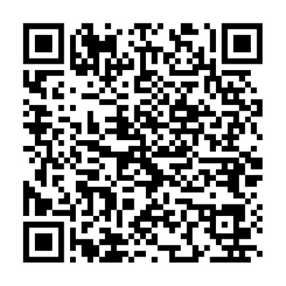
Year-Long Healing Course
48-Week Journey Into Biblical Healing with John Bodenbender
START DATE:
Tuesday, April 28
7:00-8:30 PM (Zoom)
Join us for free every Tuesday.
SCAN TO REGISTER
~ Believe for Healing
~ Receive Healing
~ Minister Healing
Email: john.bodenbender1@gmail.com

Slide 6


Slide 7


Slide 8


Slide 9


Slide 10


Visit the INFO TABLE in the foyer and check out which HOME GROUP is best for you!

Slide 11


Slide 12


Slide 13


