Slide 1


Slide 2


Slide 3

Prague Christian Fellowship
4th Sunday
New Connections
Lunch
  Light lunch with new friends
  Get to know the pastors and a few leaders
  Learn the history of PCF, the core values, and ask anything!
Every 4th Sunday after the Sunday Service in the Sunday School room.

Slide 7


Slide 8



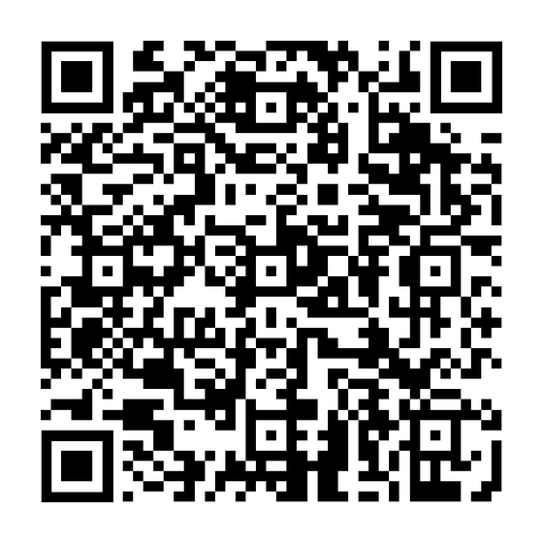
Open Heaven 2026
SCAN TO REGISTER
Bobbio Pellice, Italy
JUNE 4-8
WORSHIP ~ TEACHING ~ FELLOWSHIP

Slide 9


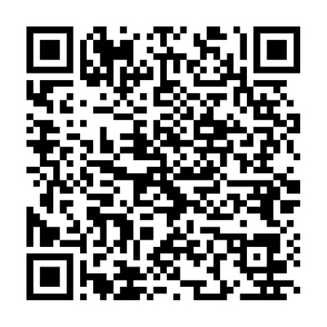
Year-Long Healing Course
48-Week Journey Into Biblical Healing with John Bodenbender
START DATE:
Tuesday, April 28
7:00-8:30 PM (Zoom)
Join us for free every Tuesday.
SCAN TO REGISTER
~ Believe for Healing
~ Receive Healing
~ Minister Healing
Email: john.bodenbender1@gmail.com

Slide 10


Slide 11


Slide 12


Slide 13


Slide 14


Visit the INFO TABLE in the foyer and check out which HOME GROUP is best for you!

Slide 15


Slide 16


Slide 17


